Slide 1
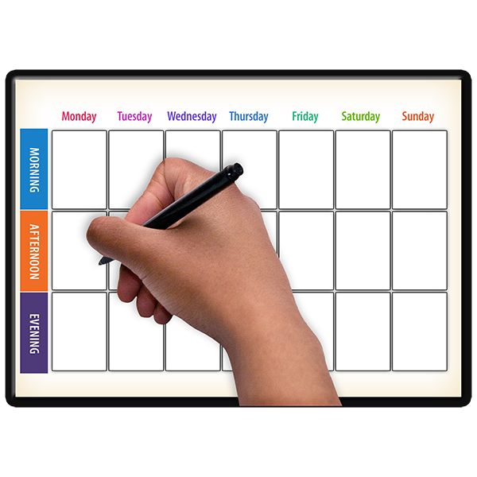
12 Ways to STOP you feeling lonely
Stay Active
Keep up to date with information
Do something meaningful
Connect with others
Connect Online
Find sources of comfort
Create something
Distract yourself
Plan for the future
Practise self care and compassion
Get into a routine
Enjoy the little things

