Slide 1
Health Inequalities and the Black, Asian and Minority Ethnic (BAME) Experience Humber, Coast and Vale ICS
‘Foluke Ajayi, Director of Strategic Transformation/Locality Director
Humber, Coast and Vale Health and Care Partnership

Slide 2
Background
Humber, Coast and Vale Health and Care Partnership (ICS) originally formed as a Sustainability and Transformation Partnership in 2016; confirmed as an ICS in April 2020
National reforms are taking place bringing all health and care systems to ICS status by April 2022
From April 2022, ICSs will become legislated bodies directly responsible for the health and wellbeing of their populations, and will be able to be held to account for this.
Notes:
Additional notes
- National reforms are taking place (UK Govt White Paper, February 2021) bringing all health and care systems to ICS status by April 2022;
- ICSs mean closer joined-up work, commissioning and collaboration between health, social care, Public Health, Local Authorities, education and the Voluntary Sector

Slide 3
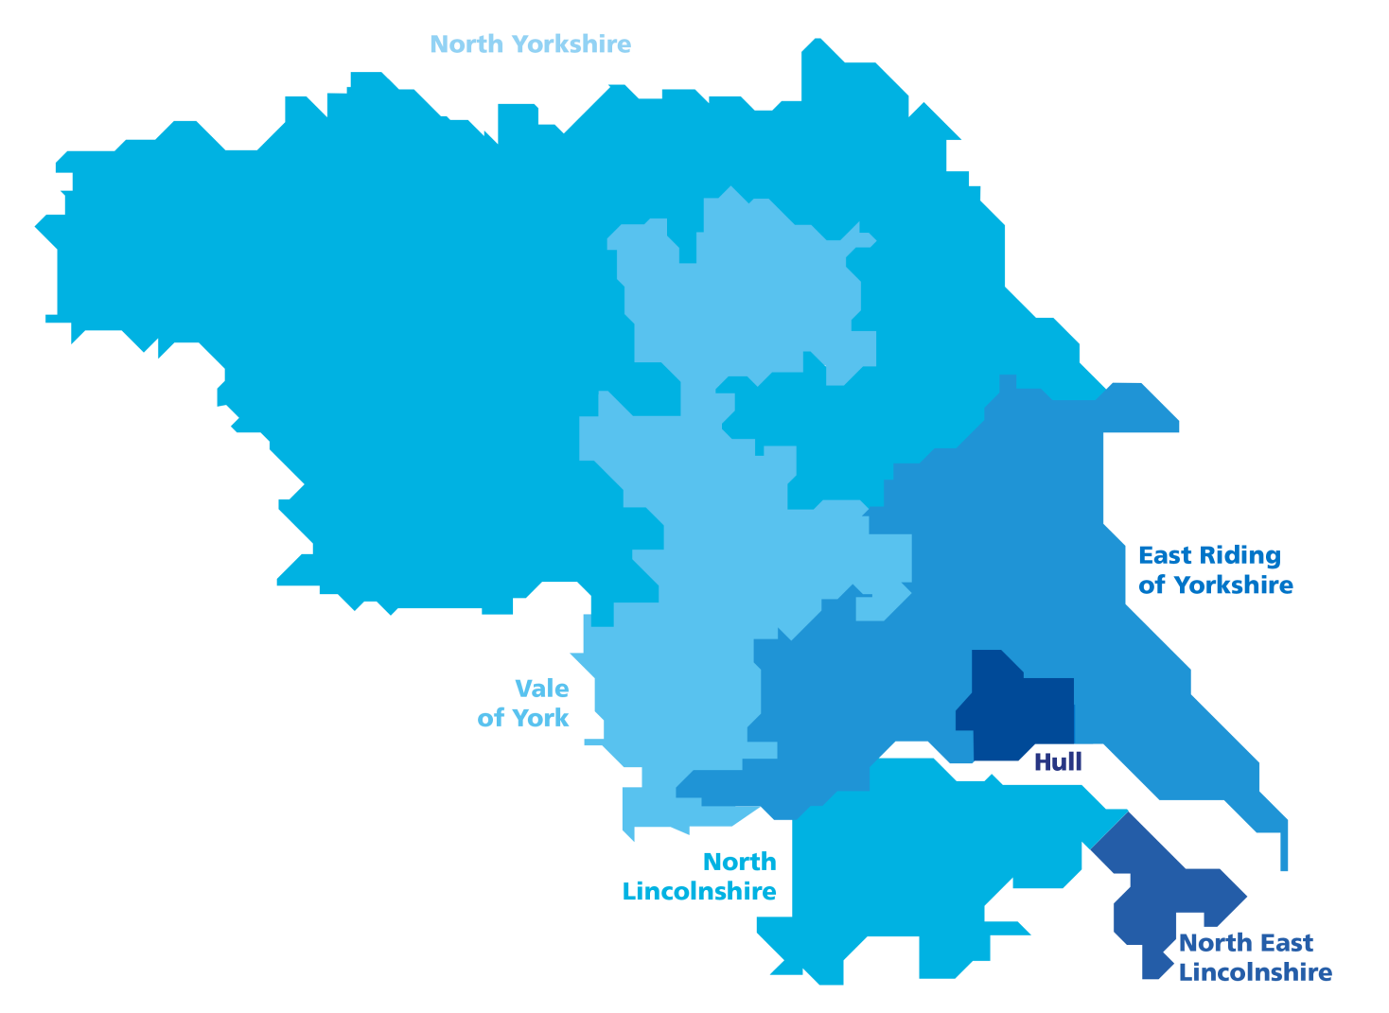
Humber, Coast and Vale
4 acute hospital trusts
(operating across
9 sites)
1.7 million people
Circa 50,000 staff across health and adult social care
3 mental health
trusts
Total budget of
approx. £3.5bn
4 community / not for profit providers
450 care
homes
34 Primary Care Networks
140 home care
companies
2 ambulance trusts
7 hospices
6 clinical commissioning groups (CCGs)
6 local authorities
1000s of voluntary and community sector organisations

Slide 4
HCV Demographics
HCV population: 1.7 million citizens
BAME population sits just under 60,000 = 3.6%
The higher proportion (circa 20%) of BAME workforce in HCV requires greater reflection and representation at Board levels across the ICS (which are currently majority white)
Steve Russell, Executive Lead for HCV’s BAME Programme, is leading a newly-formed ‘BAME Staff Network of Networks’ based on the successful West Yorkshire & Harrogate model.
Notes:
Additional Points to make
The BAME workforce in HCV does not reflect its population and is much higher; in some Trusts and organisations this is 20% and higher when including bank and agency, locum staff etc
In comparison to neighbouring ICSs (West Yorkshire and South Yorkshire) we may have a less diverse population but we have high levels of deprivation – particularly in coastal and inner city areas – leading to significant inequality.

Slide 5
Overview: Health Inequalities
Nearly a quarter of our population live in areas classed as the most deprived in England
Unemployment rates also vary across the region from 3.4% in York to 9.8% in Hull
Ageing population – 20% of HCV population is over 65 (compared to 17% nationally)
Some of the worst rates of smoking prevalence in England
Air pollution and climate change – the Humber’s CO2 emissions are double national levels (largely due to industry, ports, infrastructure)
Notes:
Notes
Our HCV region is home to thriving cities, striking coastline and beautiful countryside – yet nearly a quarter of our population live in areas classed as the most deprived in England
Humber is ranked 5th nationally as a most deprived area in terms of Local Authorities and Local Enterprise Partnerships funding
Average weekly wages range from £346 in North East Lincolnshire to £449 in York (compared to £530 nationally)
Unemployment rates are worsening during the pandemic (3.4% in York to 9.8% in Hull )
We have an ageing population
We have high levels of smoking prevalence
Air pollution - Humber CO2 emissions are double the national levels and studies have also shown that Drax Power Station in Selby, North Yorkshire is above the recommended levels of dust particle pollution and growing. Direct impact on health, wellbeing and respiratory conditions. Climate change and carbon emissions are both increasingly recognised as a health emergency and area of significant inequality.

Slide 6
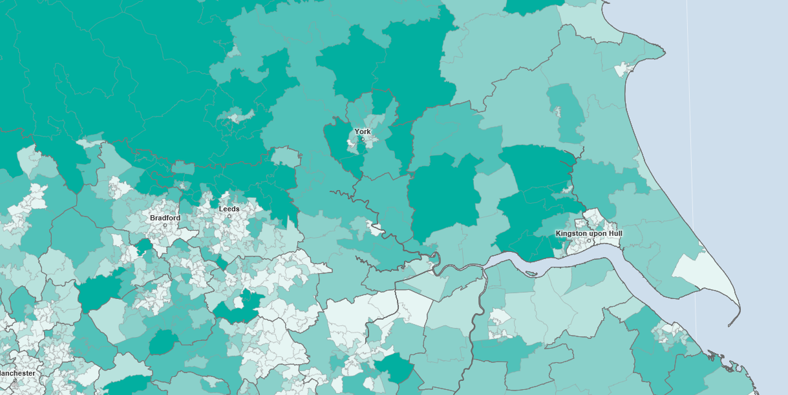
Health Inequality: Life Expectancy
Huge difference in healthy life expectancy between poorer and richer areas
Healthy life expectancy for females, 2009-2013 (years)
Lowest in HCV area:
53.1 (East Hull)
Highest in HCV area:
73.5 (Richmondshire)
Notes:
Large disparity in healthy life expectancy across HCV region, presenting additional geographical challenges;
Our population are spending an increasing proportion of their lives with one or more serious health conditions
Women living in North East Lincolnshire can expect to live around the last 22 years of their lives in ill health and men in Hull can expect to live around 19.5 years of their lives in ill-health

Slide 7
BAME Health Inequalities (1)
It is well known that BAME colleagues and communities have been disproportionately affected by the Covid-19 pandemic
Ongoing reviews by health systems and the UK Government are taking place to understand what is driving this inequality (e.g. Public Health England, 2020 and WYH ICS Report, 2020)
Black Lives Matter, 2020 protests and ongoing movement
We know there is much more work to do before we can see a health system free of systemic injustice and health inequality.
Notes:
It is well known that BAME staff and communities have been disproportionately affected by the Covid-19 pandemic.
Ongoing reviews are trying to understand this in more detail.
2020: Black Lives Matter protests brought racial inequality firmly into the public arena – injustices exacerbated by police violence, systemic racism, institutionalised prejudice and Covid inequalities
For example, BAME groups are currently less likely to come forward for Covid vaccination (both staff and in the community) and work is ongoing to address concerns and bust myths
For example: Higher rates of mortality were seen for some ethnic groups compared to others during Covid. In comparison to previous years, all-cause death was almost four times higher than expected amongst Black people in March-May 2020, almost three times higher in Asian males and almost twice as high in White males. Among females, deaths were almost three times higher in this period in Black, mixed and other females, and 2.4 times higher in Asian females compared with 1.6 times higher in White females.

Slide 8
BAME Health Inequalities (2)
No existing HCV-specific data on BAME health inequalities
Baseline health inequalities assessment for HCV is in the pipeline and will include BAME communities
The support needs of BAME colleagues and white allyship is also a priority of the new Staff Network of Networks led by Steve Russell
West Yorkshire & Harrogate ICS Report, October 2020 “Review into the impact of COVID-19 on health inequalities and support needed for Black, Asian and minority ethnic (BAME) communities.”
Notes:
Limited information is available (at present) on BAME communities and their health and care needs within HCV boundaries but work is taking place to address this via the Population Health and Prevention Board in the form of a baseline assessment, which will be commissioned for the ICS and include BAME communities.
Summary of the WYH ICS Report 2020 is provided in the upcoming slide as an overview and to give an idea of the inequalities we expect to find in HCV, with some geographical variance.

Slide 9
West Yorkshire & Harrogate ICS Report
At a glance: - BAME communities are vulnerable to poorer health outcomes - There are key factors that can increase inequalities further such as intersectionality with deprivation - Mental health outcomes are particularly poorer for BAME groups - Covid-19 and the economic recession is driving greater inequality
Summary of recommendations: 1) Improve access to safe work for BAME people 2) Ensure the ICS’s leadership is reflective of communities 3) Use information and data to plan services that meet different groups’ needs through population planning 4) Reduce inequalities in mental health outcomes by ethnicity
https://www.wyhpartnership.co.uk/publications/tackling-health-inequalities-for-bame-communities-and-colleagues
Notes:
BAME communities make up 20% of WYH population (2011 Census)
Full title of the report: “Review into the impact of COVID-19 on health inequalities and support needed for Black, Asian and minority ethnic (BAME) communities” published in October 2020
This review specifically aimed to understand this impact on BAME communities and staff. The aim was to review existing work, to explore if this work was sufficient to address this impact and to identify recommendations for action to reduce this impact.
Report also found (quote from Rob Webster): “Not all experiences are equal and our current language does not account for the different ways in which different ethnic minorities experience racism. Racism is experienced differently and to different degrees by different groups of people. It is unhelpful to suggest that BAME groups are in perfect racial solidarity - that all racism is the same and that all ‘BAME’ people have the same life experiences and values. The experiences of BAME communities and staff, in and out of the workplace, differ considerably and it is our role as a large health and care partnership to take this into account and make a positive difference to people’s lives with them.”
This is a summary of their findings and recommendations but I recommend that you see the full report for the detail – link provided.

Slide 10
What causes Health Inequalities?
“What causes these inequalities is the subject of much debate but much can be linked to the deeper impact of wider societal inequalities beyond the operation of health and social care services.
“These include broader environmental, social and economic factors that exert a profound ability to shape health outcomes for communities”
Notes:
This is a very complex area.
It is made more complex by the role of systemic and institutionalised racism and discrimination, as the Black Lives Matter movement has shown around the world. UK examples might be the Grenfell Tower fire, Windrush Scandal, Stephen Lawrence murder, and Covid-19.
Quote taken from p.6 of the WYH ICS Report

Slide 11
The Role of Prevention
Many diseases and conditions are preventable
Poverty, poor housing, poor education, poor employment opportunities, exposure to crime, discrimination and prejudice, and environment all affect people’s ability to thrive and live well
Covid-19 has shone a light on the role health inequalities (but also preventative action) play in health outcomes for populations
Prevention goes beyond individual responsibility, which is where the role of the State/Government/System comes in
Notes:
However, many diseases and conditions (and health inequalities!) are preventable and can be dismantled .
Poverty, poor housing, education and employment, crime, discrimination and environment can all be addressed and tackled.
Covid19 - BAME communities, older people, patients with Learning Disabilities, and those with underlying illnesses have all been disproportionately affected or at risk during the pandemic. This has raised the profile of health inequalities.
WYH Report – “It is important to state that the differential impact of COVID-19 on BAME communities is not specifically as a result of genetic vulnerability to the disease but largely as a result of forces that shape and structure labour markets, housing and workplace cultures which culminate in an elevated risk profile for some BAME communities.”
Due to the complexity of health inequalities they can often only be solved by state intervention to address systemic issues, e.g. via public health reforms, new anti-discrimination laws and legislation, population health management, affirmative action etc.

Slide 12
Prevention and Population Health
Public Health – the determinants of health:
…healthcare is not the main determinant of health.
Notes:
This is to demonstrate that healthcare is not the main determinant of health.

Slide 13
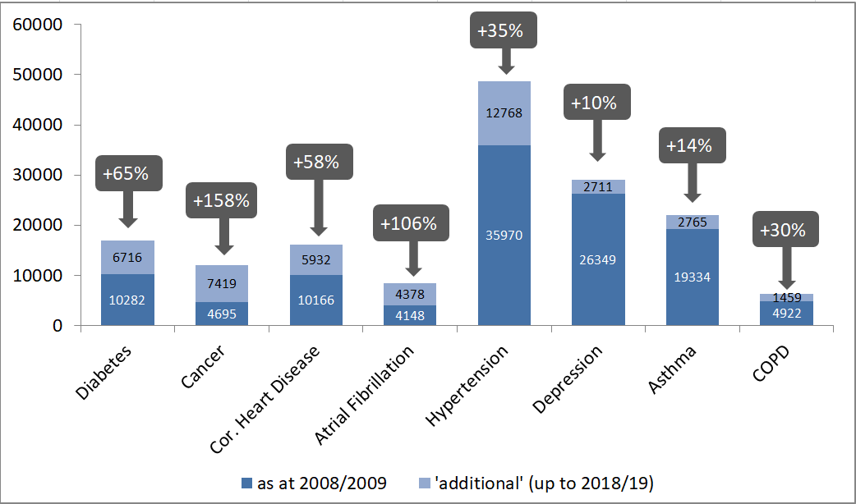
Prevention – never more necessary
Huge increase in incidence and prevalence of chronic disease
Number of people on a QOF disease register in 11 GP practices in York, comparing a decade ago with today, with % increase
Notes:
Increasing rates of chronic disease, with an example of York given, in comparison to 10 years ago.

Slide 14
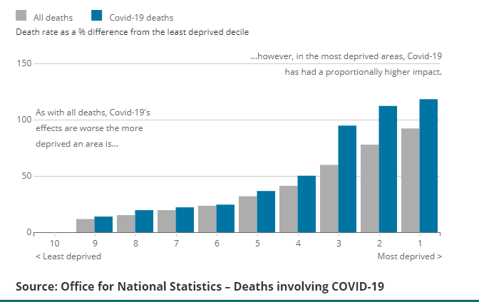
Health Inequality and Covid-19
Huge social gradient in all-cause mortality, but even bigger in COVID-19 mortality
Death rate from all causes and COVID-19 specific, by deprivation decile
Notes:
This shows that Covid 19 mortality gets worse the more deprived an area is.

Slide 15
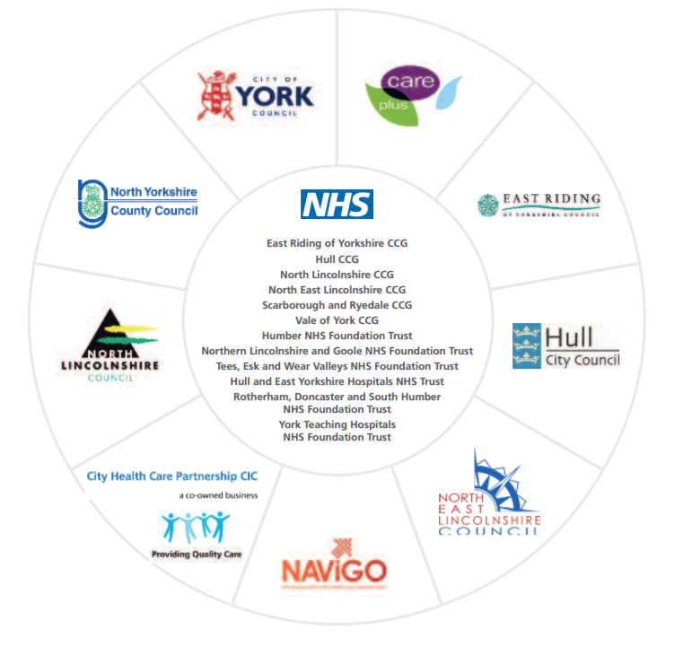
Organisations in our Partnership
6 CCGS | Hull East Riding of Yorkshire North Lincolnshire North East Lincolnshire Vale of York North Yorkshire
4 Acute Trusts | Northern Lincolnshire & Goole NHS Foundation Trust York Teaching Hospitals NHS Foundation Trust Hull and East Yorkshire Hospitals NHS Trust Harrogate Foundation Trust
3 Mental Health Trusts | Humber NHS Foundation Trust Tees, Esk and Wear Valley NHS Foundation Trust Rotherham, Doncaster & South Humber NHS Foundation Trust
6 Local Authorities | East Riding of Yorkshire Council Hull City Council North Lincolnshire North East Lincolnshire Council City of York Council North Yorkshire County Council
2 Ambulance Trusts | East Midlands Ambulance Service NHS Trust Yorkshire Ambulance Service NHS Trust
Community Service Providers | City Healthcare Partnership Navigo Care Plus Group Focus

Slide 16
Our Shared Purpose
Together we will:
Population health | Design, facilitate and deliver a population health and care system that improves the lives of our people and strengthens our commitment to and investment in, public health by making evidence-based decisions using the best available data from across all sectors.
Prevention | Put the prevention of ill health and the health and wellbeing of our population at the front and centre of all our activities, with an emphasis on reducing inequalities.
Partnership | Ensure in a shared endeavour across agencies, with communities, and with the people who use our services to listen to and involve them in delivering and making decisions on the shared purpose, vision and priorities, in our efforts to make them a reality.
Place | Ensure subsidiarity and reinforce the primacy of place in all of our activities by working together at the right level for the decisions and actions required: generally local, sometimes across the Partnership and other times wider e.g. Yorkshire and the Humber.
Politics and the public | Work closely with our local politicians in ensuring maximum engagement and public ownership of our strategies, plans and actions. In so doing, use our collective strength to punch our weight regionally and nationally.
Pace | Create a culture and an environment for swift and agile implementation of our plans
Pandemic | Collectively use our resources at every level to combat COVID 19 and limit its impact and to be able, as a system, to manage both response and recovery.

Slide 17
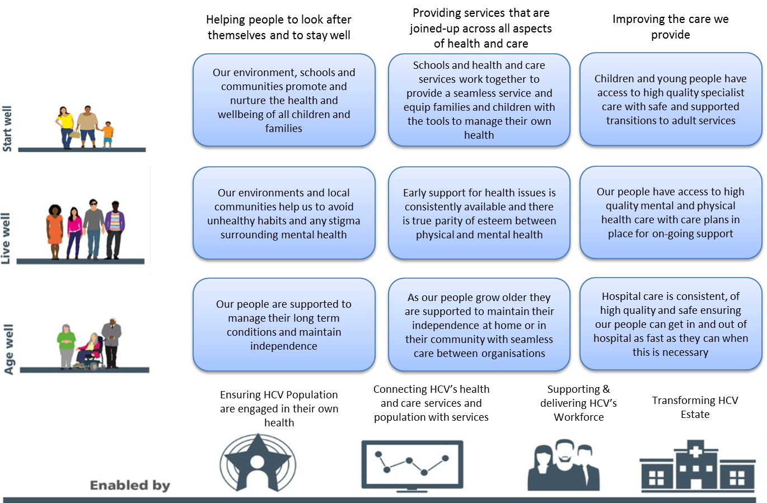
Our Shared Vision

Slide 18
HCV action on Health Inequalities
ICS-wide Prevention and Population Health Management (PHM) Board, established summer 2020
Baseline assessment of Health Inequalities to be commissioned via this Board
7 Primary Care Networks are currently implementing a PHM pilot programme
Work at place and neighbourhood level through Health and Wellbeing Boards and public health teams
Commitment from Partnership Executive Board to support the new BAME Network of Networks, programmes and anti-racism work.
Notes:
ICS-wide Prevention and Population Health Management (PHM) Board, established summer 2020
Membership includes partners across health, social care, Public Health, local authorities and voluntary sector
7 Primary Care Networks are currently implementing a PHM pilot programme focused on interventions aimed at specific patient cohorts (learning from this to be scaled up across the ICS to embed a PHM-approach in everything we do). PHM aims to directly tackle health inequality through population planning.
Wider work taking place in York and North East Lincolnshire around finance and contracting, and relating this to PHM approaches
Work at place and neighbourhood level through Health and Wellbeing Boards and public health teams
Commitment from Partnership Executive Board to support the new BAME Network of Networks, programmes and anti-racism work. The new BAME Network of Networks is also in the process of developing its priorities and action plan.

Slide 19
Group Discussion / Q&A

