Slide 1
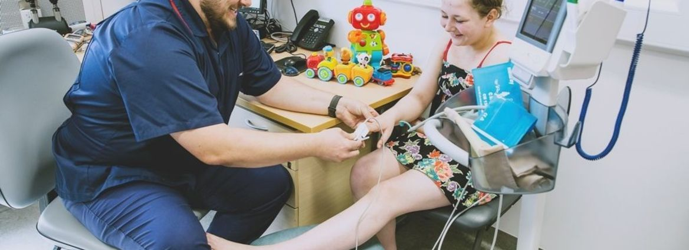
Patient Satisfaction Survey 2019/20
Key Findings

Slide 2
Introduction & Methodology
9th consecutive patient survey
Telephone & Face to Face
approach
2263 Patients surveyed
Surveys collected from
Apr 2019
to
Apr 2020
Data analysed by Directorate and
Service Area
Questions consistent for comparability

Slide 3
Samples Sizes
Directorate | Service Area | Sample
Integrated Community Care Services | Therapies & Rehab | 631
Integrated Community Care Services | Nursing & Conditions | 366
Health & Wellbeing Services | Integrated Urgent Care | 450
Health & Wellbeing Services | Primary Care AMPS & CHPL | 188
Health & Wellbeing Services | Integrated Sexual Health | 174
Health & Wellbeing Services | Dental Services | 121
Health & Wellbeing Services | 0-19 Services | 100
Health & Wellbeing Services | Psychological Wellbeing Services | 80
Health & Wellbeing Services | Pain Management | 60
Health & Wellbeing Services | Community Paediatrics & Nursing | 50
Health & Wellbeing Services | Public Health | 26
Health & Wellbeing Services | Carers’ Information & Support Service | 12
Health & Wellbeing Services | Evolve Eating Disorder Service | 5

Slide 4
Overall, more than 9 in every 10 satisfied with initial contact
0%
How satisfied were you with the initial contact with the service? NET Satisfaction
94%
Net Satisfaction
2018/19
Q3a How satisfied were you with the initial contact with the service?
Notes:
NET satisfaction maintained since 2018/19
White (94%) vs BAME (88%) NET satisfied; White (71%) vs BAME (54%) VERY satisfied
Non-disabled (76%) vs Disabled (67%) VERY satisfied
Hull (68%) vs ER (73%) VERY satisfied
Directorate: Health & Wellbeing (65%) vs Integrated Community Care (76%) VERY Satisfied

Slide 5
Around a third of patients contacted services via telephone
Q4a How satisfied were you with the initial contact with the service?
Q4c~Q4h How satisfied were you with the following aspects of your initial contact by telephone?
Notes:
Increase from 2018/19 (32% +4%); closer to 2017/18 (39%)
Scores consistent. Getting Through (+1% from 2018/19) and Navigating Automated System (-6% from 2018/19) consistently lower amongst aspects
Getting through NET Satisfaction: Primary Care 63%); Integrated Urgent Care 76% / White (85% vs BAME (59%) small sample of BAME (24) / Hull (81%) vs ER (89%)
Automated Phone System NET Satisfaction: Primary care 62%; Integrated Urgent Care 69% / White (78% vs BAME (55%) small sample of BAME (16) / Hull (74%) vs ER (86%)

Slide 6
High levels of satisfaction when booking appointments with services
4%
12%
appointments changed / cancelled
2018/19
Q5a How satisfied were you with the following... ?
Q5b Have any of your appointments been cancelled or changed to a later date in the last 12 months?
Notes:
Date and time +1% since 2018/19
Location +1% since 2018/19
Out of hours + 5% since 2018/19
+4% of appointments changed or cancelled since 2018/19

Slide 7
Vast majority of patients continue to be satisfied with health professionals
Q9a Thinking about the health professional that you saw. How satisfied or dissatisfied were you with the following?
Notes:
Consistently high – knowledge of medical history -1% from 2018/19
Care and Concern: White (98%) vs BAME (92%)
Taking Problems Seriously: White (97%) vs BAME (91%)
Respectful: White (98%) vs BAME (94%)
Trust: White (98%) vs BAME (91%)
ER generally 1 or 2% higher than Hull

Slide 8
High levels of satisfaction with communication from healthcare professionals
Q10 Have you experienced a reduction in the number of times you have had to tell your story to different health professionals? Q11a Thinking about the health professional that you saw. How satisfied or dissatisfied were you with the following?
Notes:
Explanation of take/apply medicines +2% since 2018/19
Average score for VERY satisfied across 8 statements: Carers 100%; Evolve 100%, Dental 95% / Sexual Health 78%; 0-19 79%; Primary Care 81%
Answering any questions: White (88%) vs BAME (79%) VERY satisfied
Listening: White (88%) vs BAME (78%) VERY satisfied
Communicating: White (88%) vs BAME (80%) VERY satisfied
On average ER patients more likely to be VERY satisfied (91% vs 84 Hull)
53% reduction of story vs 46% 2018/19 +7% experienced reduction in telling story

Slide 9
More than 9 in every 10 said care encouraged them to manage conditions independently*
*Only asked to patients accessing services commissioned by CCG+
Q13a Has the care that you received supported or encouraged you to manage your condition more independently in your day to day life?
Q13b Has the care that you received contributed to an improvement in your quality of life?
Q18 Has the care that you received resulted in a positive outcome for you either in physical, psychological or social terms?
Notes:
Management of condition -3% since 2018/19
Quality of life -4% reduction since 2018/19
Setting targets for self care +2% agree +7% disagree since 2018/19
Support for long term care +5% since 2018/19

Slide 10
More than 9 in every 10 confident information is kept securely and only accessed by those involved in care
Are you confident that information about you is kept securely?
Are you confident that information about you is only accessed by people directly involved in your care?
Are you satisfied that you are kept up-to-date about how information about you is used and shared?
Q25 Are you confident that information about you is kept securely?
Q26 Are you confident that information about you is only accessed by people directly involved in your care?
Q27 Are you satisfied that you are kept up-to-date about how information about you is used and shared?
Notes:
1% reduction in information usage and sharing
All aspects consistent with 2018/19
Information access: White (93%) vs BAME (88%)

Slide 11
Vast majority satisfied with opportunities to give feedback and would raise any concerns
Q24 How satisfied are you with the opportunities to give feedback about the service or make a complaint?
Q25 If you were not happy with the service you received or had concerns, would you raise them?
Notes:
Feedback/complaint: -1% NET Satisfaction since 2018/19
White 72% VERY satisfied vs BAME 77% VERY Satisfied
Disability 75% satisfied vs Non disabled (71%)
Sexual Health 83%; 0-19 Services 88% NET Satisfied
Raise concerns: consistent with 2018/19
White (91%) vs BAME (85%)

Slide 12
Vast majority satisfied with standard of care and support received
How satisfied are you with the standard of care and support you have received? Very satisfied
0%
98%
NET Satisfied
2018/19
Q27a Overall...how satisfied were you with the following: - The standard of care and support you have received?
Notes:
NET satisfaction maintained since 2018/19 – consistent for 4 years
ER more likely to be very satisfied than Hull (89% vs 85%)
White vs BAME VERY satisfied (87% vs 80%)
Hull vs ER VERY satisfied (85% vs 89%)
Increases in VERY satisfied: Dental services +21%; Primary Care +13%
Decreases in VERY satisfied: Pain management -21%

Slide 13
Demographic Comparison - % Very Satisfied with standard of care and support
Q27a Overall...how satisfied were you with the following: - The standard of care and support you have received?
Notes:
White vs BAME VERY satisfied (87% vs 80%)
Hull vs ER VERY satisfied (85% vs 89%)
Older patients more satisfied

Slide 14
Overall satisfaction with standard of care and support received remains extremely high
Q32a Overall...how satisfied were you with the following: - The standard of care and support you have received?

Slide 15
More than 8 in every 10 very satisfied with overall experience
1%
How satisfied are you with your overall experience? Very satisfied
98%
NET Satisfied
2018/19
Q27b Overall...how satisfied were you with the following: - your overall experience?
Notes:
1% drop in satisfaction since 2018/19 (NET satisfied)
Significant difference between White/BAME for VERY satisfied (82% vs 69%)
Significant difference between Hull/ER for VERY satisfied (79% vs 85%)
Increases in VERY satisfied: Primary Care +17%; Dental Services +19%; Psychological Wellbeing +6%
Decreases in VERY satisfied: Pain Management -22%; Therapies and Rehab -6%
Directorate: Health & Wellbeing (77%) vs Integrated Community Care (86%) VERY Satisfied

Slide 16
Demographic Comparison - % Very Satisfied with Overall Experience
Q27b Overall...how satisfied were you with the following: - your overall experience?
Notes:
Significant difference between White/BAME for VERY satisfied (82% vs 69%)
Significant difference between Hull/ER for VERY satisfied (79% vs 85%)
Older people more satisfied

Slide 17
Satisfaction remains extremely high with overall experience
Q32a Overall...how satisfied were you with the following: - your overall experience?

Slide 18
Vast majority likely to recommend service to friends and family
2%
How likely are you to recommend our clinic/service to friends and family if they needed similar care or treatment? NET Likely
94%
NET Likely
2018/19
Q1 How likely are you to recommend our clinic/service to friends and family if they needed similar care or treatment?
Notes:
Increase of 2% since 2018/19 (NET Likely) – All time high
White patients more likely to be EXTREMELY likely to recommend than BAME (60% vs 43%)
Disability more likely to be EXTREMELY likely to recommend than non disabled (69% vs 55%)
6 services attained 100% compared to 5 during 2018/19
Increases in likeliness overall: Dental +13%; Primary Care +10%
Decreases in likeliness overall: Pain management -8%
No less than 9 in every 10 would recommend across all services – improvement on 2018/19
Directorate: Health & Wellbeing (52%) vs Integrated Community Care (69%) VERY Likely

Slide 19
Demographic Comparison - % Extremely Likely to Recommend
Q1 How likely are you to recommend our clinic/service to friends and family if they needed similar care or treatment?
Notes:
White patients more likely to be EXTREMELY likely to recommend than BAME (60% vs 43%)
Disability more likely to be EXTREMELY likely to recommend than non disabled (69% vs 55%)
Older patients more likely to recommend
Significant difference between Hull/ER for EXTREMELY Likely (52% vs 69%)

Slide 20
Highest percentage of patients likely to recommend treatment to friends and family
Q1 How likely are you to recommend our clinic/service to friends and family if they needed similar care or treatment?

Slide 21
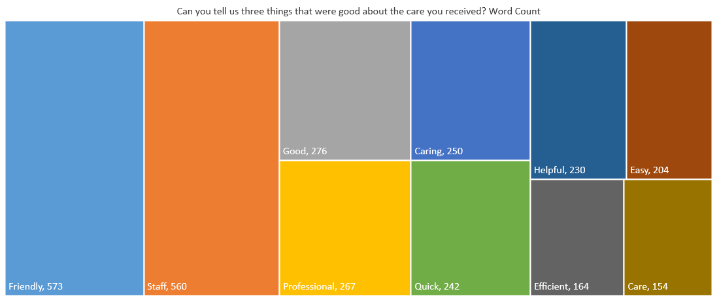
Key words include friendliness, staff, professionalism, care and help
Q28 Can you tell us three things that were good about the care you received?

Slide 22
Comments
“I feel like they listen to me and understand that my needs are different to others, so I feel like I am treated like an individual and not expectations of a chart.”
“They have been helpful and kind to me, I never feel rushed and are incredibly supportive. I have been given some really good advice on diets and how it will help me.”
“They were really professional, friendly, caring, considerate and they were lovely. They were always on time. They were really good.”
“The response to my request to engage into the service was excellent. The treatment by the receptionist staff at the location was very professional and the actually clinic nurse was excellent.”
“Nurse was really supportive and friendly. Could not have asked for more. Got an appointment straight away. Gave us medication also.”

Slide 23
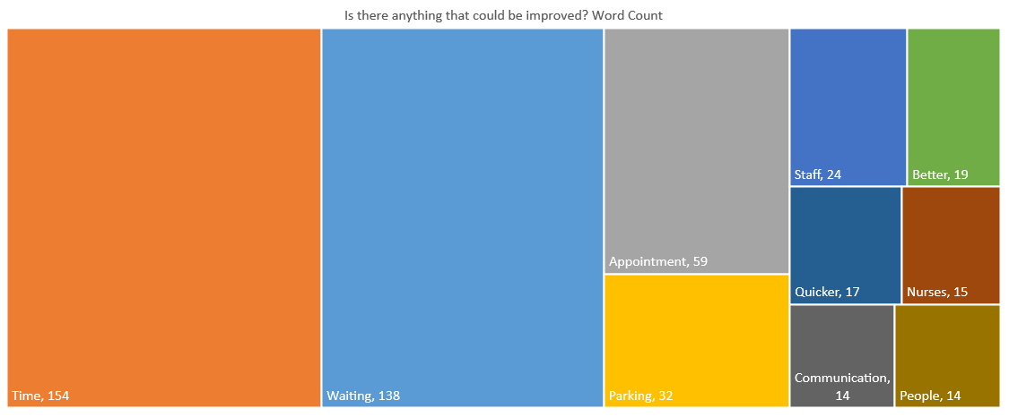
Key improvement themes include waiting times, appointments and parking
Q28 Is there anything that could be improved?

